Slide 1


Data Science in Context
AF Adham Shaazi afshaazi@yahoo.com
Session 1
23 Sept 2017

Slide 2
Section 1: Data Science in Context

Slide 3
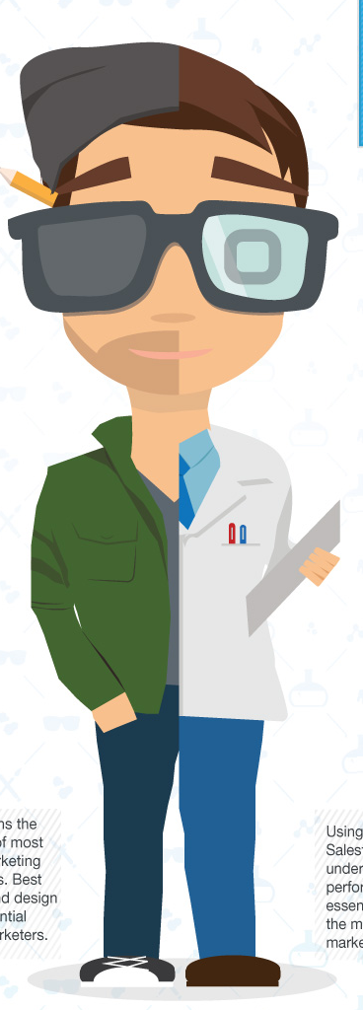
Data Science.. both an Art and a Science
Repetitive discovery of data and data sources
Applying highly technical techniques and tools
Obtaining predictive, actionable insights from data
Creating Data Products that add business value
Storytelling of relevant insights from data
Helping stakeholders in decision making that drive business value

Slide 4
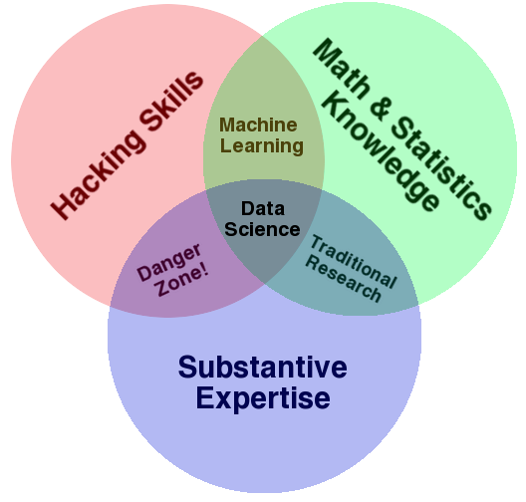
Data Science – convergence of many skills
Source: Drew Conway - http://drewconway.com/zia/2013/3/26/the-data-science-venn-diagram

Slide 5
Qualities of a Data Scientist
Curious and creative - skeptical, inquisitive
Skeptical - Applies the scientific method
Quantitative - Knows statistics, probability theory, machine learning
Technical - Good at Coding & Hacking
Communication - Good at storytelling of business stories from data
Domain expertise – has necessary amount of domain knowledge

Slide 6


Data Science Skills Sets
Statistics
Software Engineering
Visualization / Story Telling
Probility, Regression
Requirements Engineering,
QA and Testing, Programming
Infographics, Story-telling
Presentation Skills
Mathematics
Data Engineering
Business
Users
Business Analysis
Linear Algebra, Multivariate Calculus
Hidden Markov Models
Data
Hadoop, Spark, Flume,
SQL, NoSQL, ETL
Subject Matter knowledge
Financial analysis
Machine Learning
SVM, Ensemble Trees
Clustering, Deep Learning
NLU, Sentiment Analysis

Slide 7
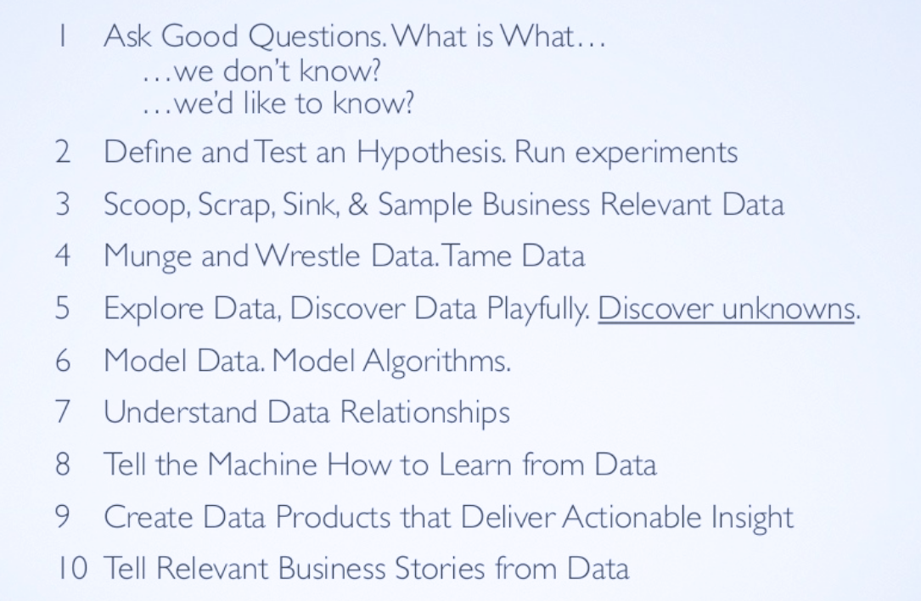
What Does a Data Scientist Do

Slide 8
Data Products
Data products are:
crafted from data
produced through exploration and iterations
machines that learn from data
answers to known unknowns and unknown unknowns
provides immediate business value
often probabilistic window of future events or behaviors
Examples of data products:
model that predicts which customers likely to increase purchases given which promotions
model that predicts customer lifecycle value given customer attributes and history
automated triggering of business process under certain conditions
visualization that provides insight that helps strategic decision making e.g. products to introduce and/or market segments to target

Slide 9
A Data Scientist’s Technical Toolkit
Java, R, Python, Haskell, Scala
Hadoop, Spark, HDFS, MapReduce, Storm
Hbase, Pig, Hive, Impala
ETL, Webscrapers, Scrapy, Flume, Kafka, Sqoop
SQL, RDBMS, DW, OLAP
Weka, RapidMiner, SciPy, NumPy, scikit-learn, pandas
SPSS, MATLAB, SAS
MongoDB, Cassandara, Neo4j, Couchbase
Microsoft Excel

Slide 10
Learning from Data is Challenging
Statistical vs Machine Learning
Supervised vs Unsupervised Learning
Induction vs Deduction
Sampling & Confidence Intervals
Probability & Distribution
Deviation & Variance
Correlation vs Causation
Causation & Prediction

Slide 11
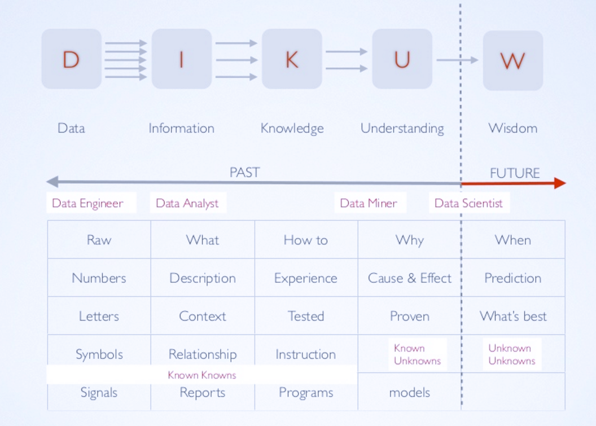
Pipeline from Data to Wisdom

Slide 12
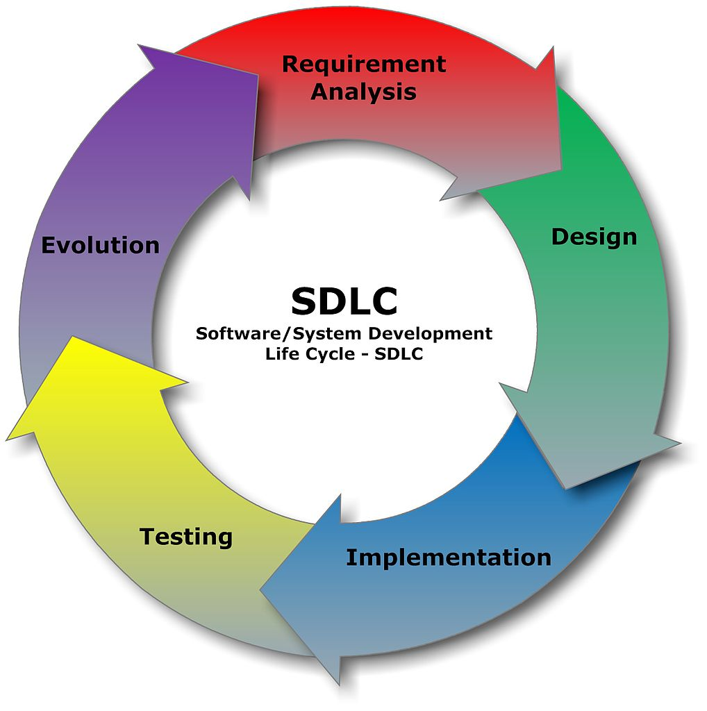
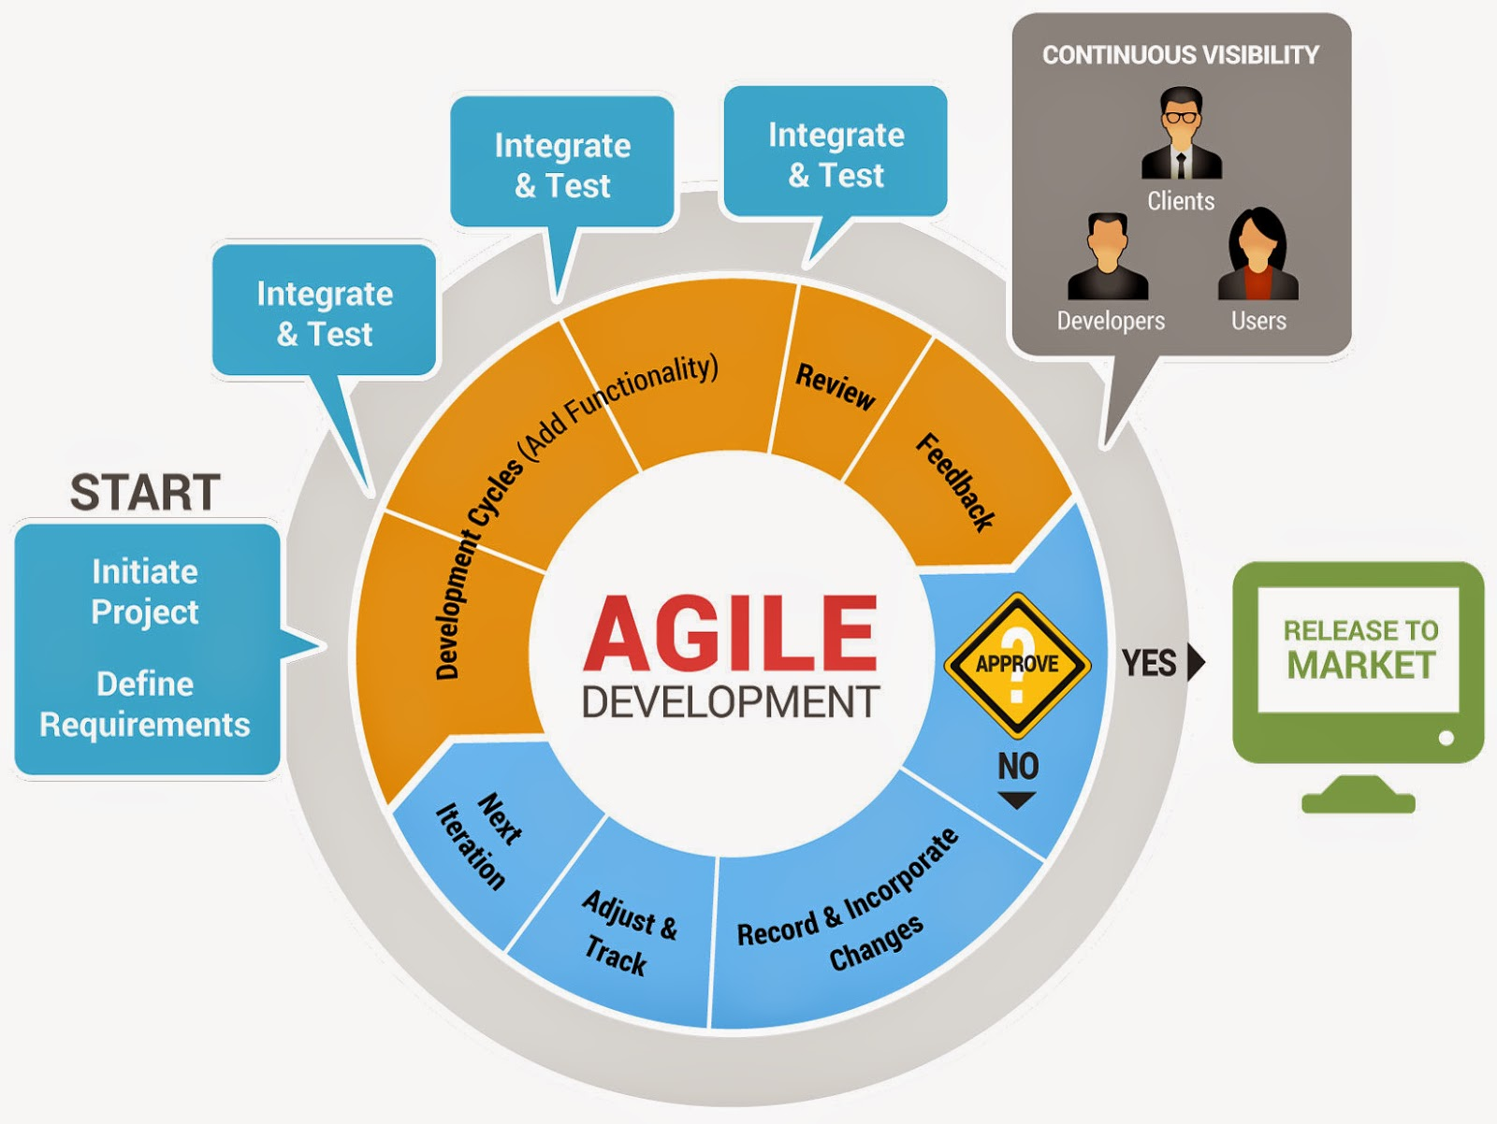
Software Development Methodologies (SDLC and Agile)

Slide 13
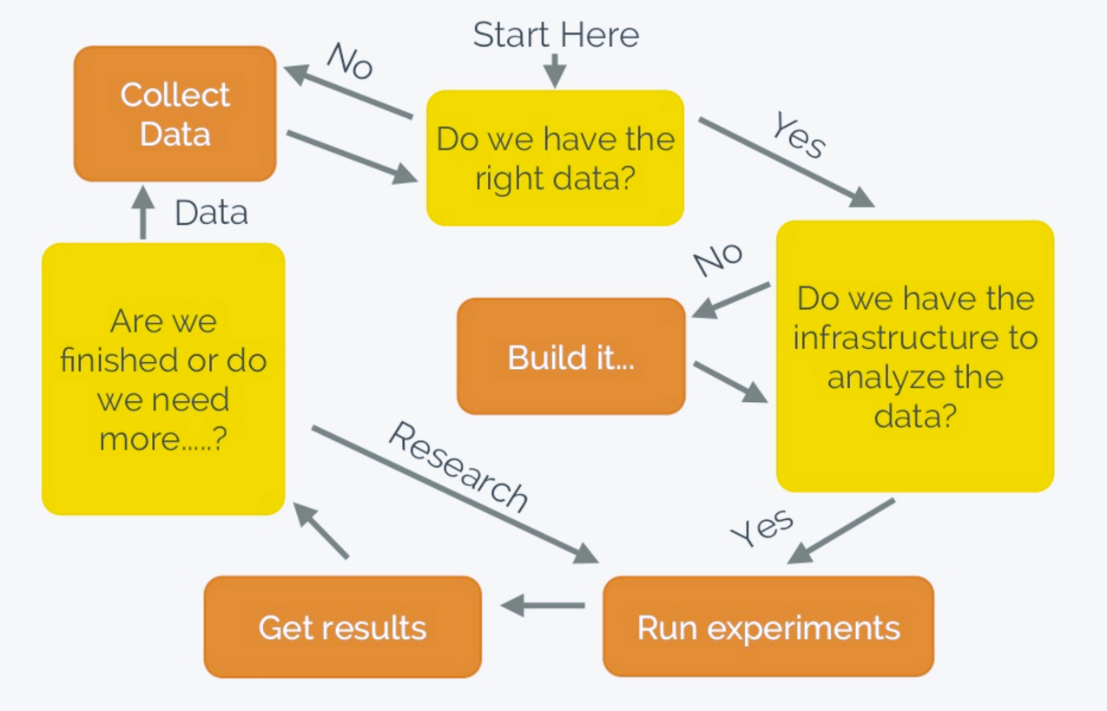
Data Science Methodology (iterative and agile-ish)

Slide 14
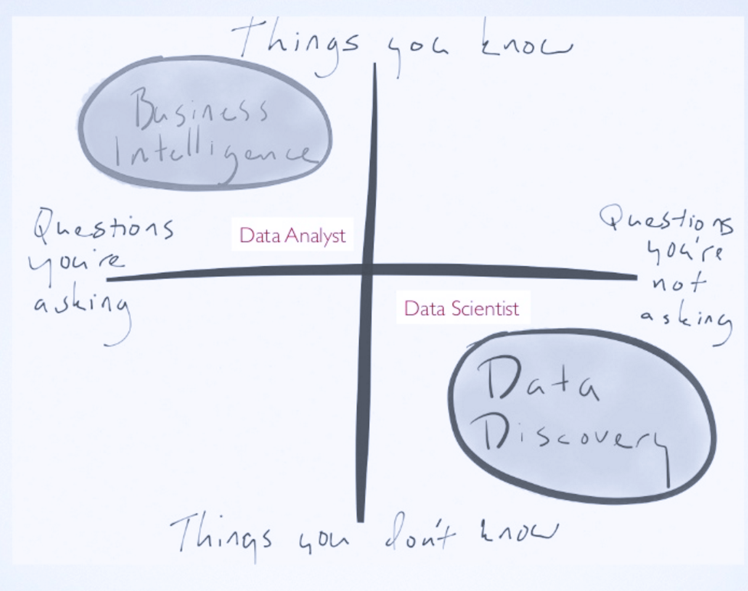
Data Discovery?

Slide 15
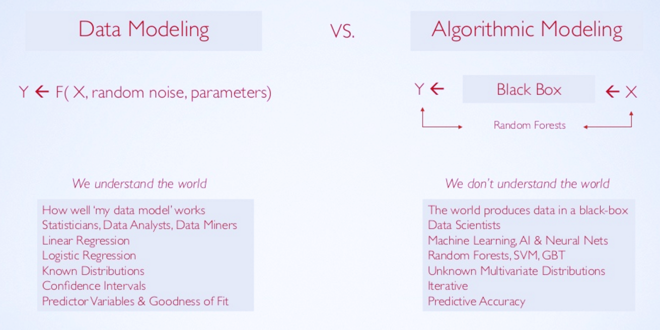
Data Modeling vs Algorithnmic Modeling

Slide 16
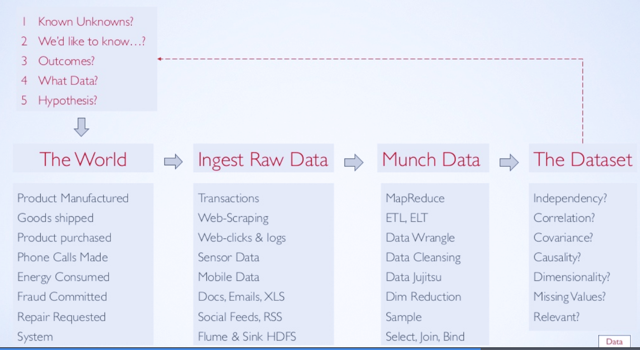
Data Science Process I

Slide 17
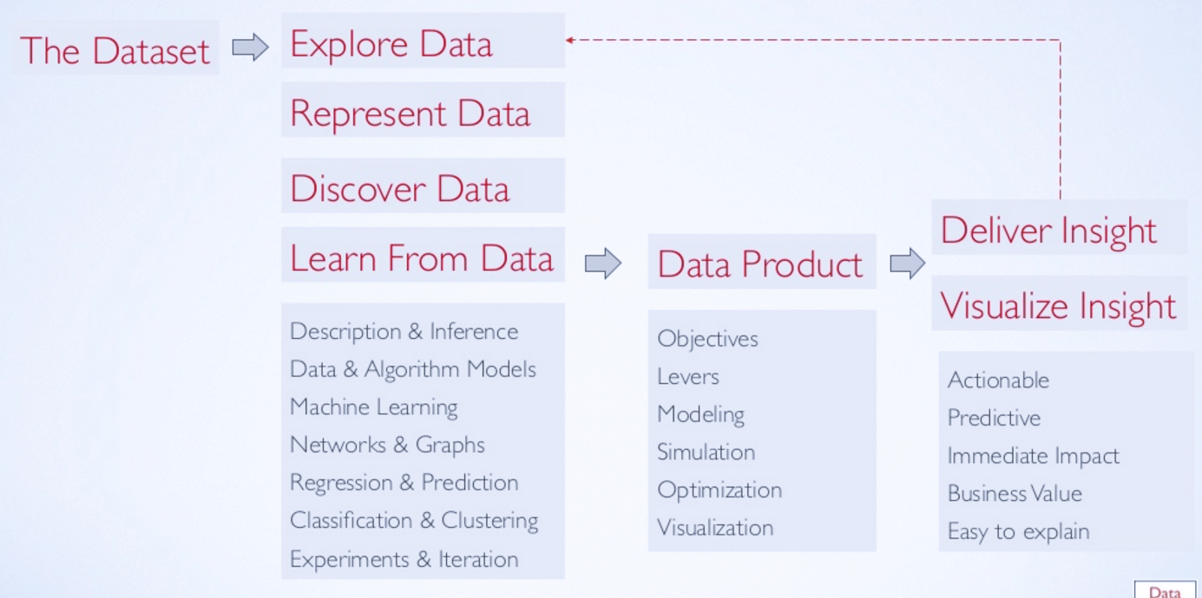
Data Science Process II

Slide 18
Section 2: Data Challenge

Slide 19

Challenge 1
Your client, a foreign telco in a country with no biometric identity validation infrastructure, has come to you with a problem of high rate of defaulting accounts, some that are registered with fraudulent identity documents.
Your task is to explore a model to predict accounts that are prone to default. What would you high-level strategy in developing this model? Provide examples of:
possible useful data sets
relevant stakeholders
required expertise

Slide 20
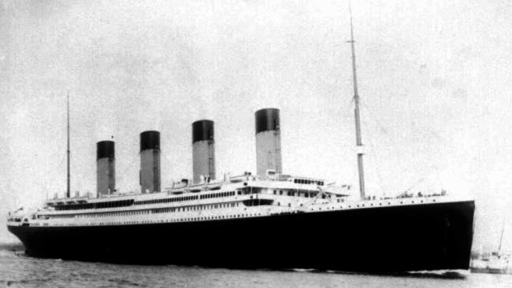
Challenge 2
The sinking of the RMS Titanic is one of the most infamous shipwrecks in history. One of the reasons that the shipwreck led to such loss of life was that there were not enough lifeboats for the passengers and crew. Although there was some element of luck involved in surviving the sinking, some groups of people were more likely to survive than others, such as women, children, and the upper-class.
Challenge: Predict what sorts of people were likely to survive.

Slide 21
Challenge 2 – the dataset
The data has been split into two groups:
Titanic-Survivor-train.csv (training set)
Titanic-Survivor-test.csv (test set)
Variable
Definition Key
survival Survival 0 = No, 1 = Yes
pclass Ticket class 1 = 1st, 2 = 2nd, 3 = 3rd
sex Sex
Age Age in years
sibsp # of siblings / spouses aboard the Titanic
parch # of parents / children aboard the Titanic
ticket Ticket number
fare Passenger fare
cabin Cabin number
embarked Port of Embarkation C = Cherbourg, Q = Queenstown, S = Southampton
pclass: A proxy for socio-economic status (SES)
1st = Upper, 2nd = Middle, 3rd = Lower

Slide 22
Section 3: Building and Managing a Data Science Team

Slide 23
Critical Success Factors for Data Science Projects
BUSINESS
Strong stakeholder buy-in
Alignment with business drivers
Strong communication skills – visualization and storytelling
Strong business understanding within team
TECHNICAL
Strong analytics skills within the team – statistics, machine learning, business analysis
Strong software engineering skills
ORGANIZATIONAL
Data-centric processes
Quality and complete data available
Culture of tolerant of “successful” failures

Slide 24

Assembling a Data Science Team
Organizational Context - transformational, creating, as-a-service, crowdsourcing
Team Roles
Skills Required
Pitfalls
“Hygiene” Aspects
Copyright Marvel Comics

Slide 25
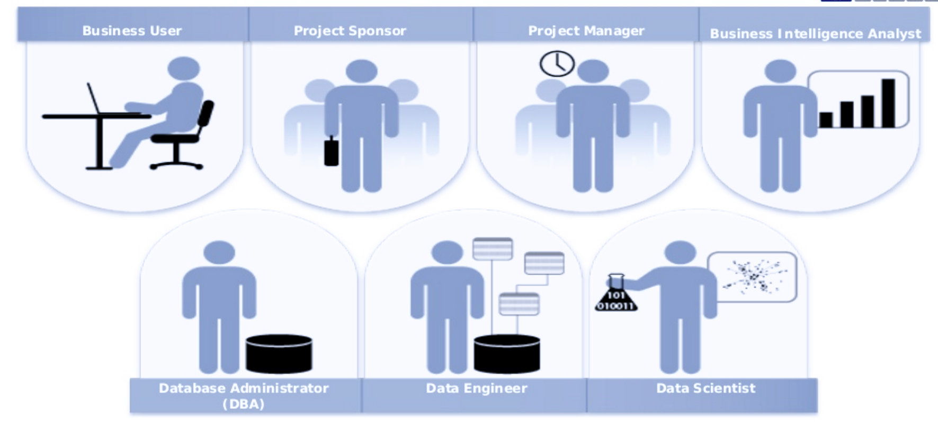
Roles to Fill in a Data Science Team
Source: “Building Data Science Teams” – EMC, presentation
https://www.slideshare.net/emcacademics/building-data-science-teams-31057129.

Slide 26
Skills Required for the Team Manager / Lead
develop depth and breadth in analytics project
adept at structured thinking – ability to put structure in place
create development plan and share with team
improve data-based business storytelling skills

Slide 27
Hands-on Involvement on Data Science Effort (Depth)
difficult to lead data science team effectively unless have hands-on experience
why selling analytics to a potential can be difficult at times and can take months before the customer gives you a fair chance
help you understand why data cleaning can take, what seems like ages from the outside

Slide 28
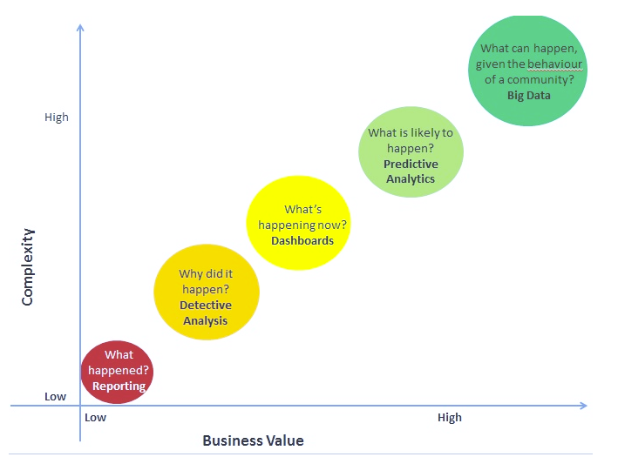
Understand Data Science landscape (Breadth)
Understand which tool and solution is best for which kind of problem
Big data? Data mart? Automated MS Excel? Pivot Charts & Tables? Tableau?

Slide 29
Apply Structured Thinking
Putting structure in place – e.g. come into meetings lacking structure and be able to guid the discussion into a structure
Some techniques:
Habit #1 from Stephen Covey’s 7 Habits – Begin with the End in Mind
Fishbone / Ishikawa diagram
Theory of Constraints (ToC thinking)
Mindmaps

Slide 30
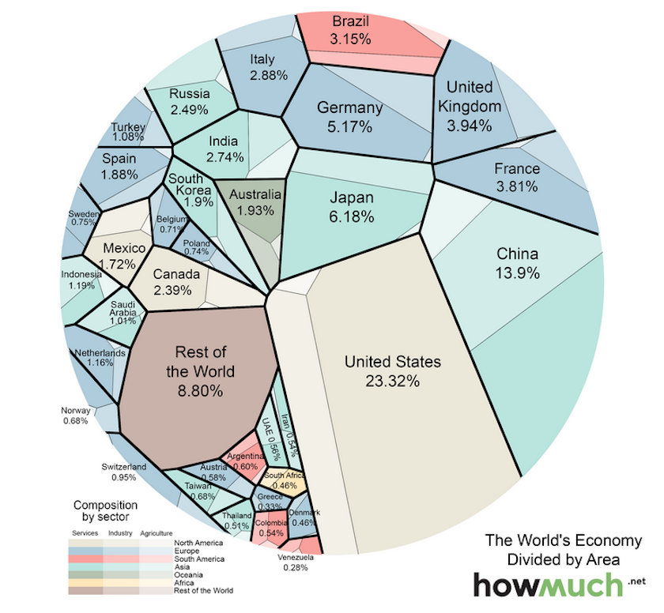
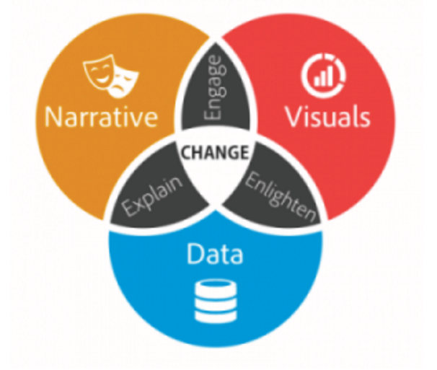
Improve Business Storytelling Skills
Add in visualizations first before presenting – make visualizations the basis of your story
Tailor highlights to audience mix and objective of presentation
Source: Brent Dykes
https://www.forbes.com/sites/brentdykes/2016/03/31/data-storytelling-the-essential-data-science-skill-everyone-needs/
Source: howmuch.net

Slide 31

Pitfalls in Managing Data Science Efforts
Sampling bias, correlation vs causation, randomness
Low quality analytics can produce wrong answers that is worse than no answer at all due to it strategic influence in decision making
Highest quality analytic product is no necessary in every case
Determining the error tolerance of the domain is key
Ideological positions are counter-productive

Slide 32
“Hygiene” Aspects of Building a Team
Build engaging environment
To be effective – need continuity
Build in slack time
ensure team has access to resource it needs – advocate for the team’s needs
team lead needs regular hands-on experience in research – able to improve abilities to estimate effort and duration – needed to interact effectively with stakeholders

Slide 33
References and Resources
https://www.ngdata.com/top-data-science-resources/
https://elitedatascience.com/data-science-resources
https://www.datascienceweekly.org/data-science-resources
https://www.slideshare.net/CasertaConcepts/introduction-to-data-science-48147149
https://www.slideshare.net/datasciencelondon/big-data-sorry-data-science-what-does-a-data-scientist-do
https://medium.com/mit-media-lab/highly-effective-data-science-teams-e90bb13bb709
https://www.analyticsvidhya.com/blog/2013/06/business-analytics-spectrum/
http://www.datasciencecentral.com/profiles/blogs/six-categories-of-data-scientists
https://www.pixability.com/building-managing-data-science-team-right-way/
https://medium.com/towards-data-science/operating-a-data-science-team-is-not-something-that-can-just-be-learned-by-watching-lectures-and-fef6ed0f714a

